Slide 1

“BODY LANGUAGE” – EVERY BODY SPEAKS !
"Let Your Presence Speak Before You Do.“
Module - 3

Slide 2

Please scan the Attendance QR Code

Slide 3

Objective:
Help nurses understand and apply effective body language techniques that enhance trust, empathy, and professionalism in patient care.
This module equips nurses with the skills to align their non-verbal communication with clinical intent, ensuring clarity, comfort, and confidence in every interaction.
Learning Outcomes:
Recognize how facial expressions influence patient perception and manage them appropriately in clinical settings.
Use eye contact to build trust while respecting cultural and emotional boundaries.
Understand how posture impacts professionalism, attentiveness, and patient comfort.
Apply supportive, controlled gestures to reinforce verbal communication.
Use movement and physical presence to positively influence the care environment.

Slide 4

BODY LANGUAGE FOR NURSES
KEY PILLARS
Facial Expressions
Eye Contact
Posture
Gestures
Movement and Presence
1
2
3
4
5

Slide 5


What Is Body Language?
Posture
Eye Contact
Gestures
Body language refers to non-verbal signals we send through………
Facial expressions
Movement
Body accounts for more than 55% of our communication and often carries more emotional weight than words.
In nursing, body language is constantly being interpreted by patients, families, and colleagues—whether intended or not.
“Your body speaks even when your mouth doesn’t.”

Slide 6

Why is Body Language Important in Nursing?
Non-verbal cues like a warm smile, eye contact, and open posture help patients feel safe, understood, and cared for.
Body language complements verbal communication, making instructions clearer and reducing misunderstandings.
Confident posture, controlled gestures, and appropriate facial expressions convey competence and reliability.
1. Builds Trust and Rapport
2. Enhances Communication
3. Reflects Professionalism
4. Supports Emotional Connection
5. Improves Patient Outcomes
6. Strengthens Team Interactions
Empathetic expressions and attentive body language show compassion, especially when words are not enough.
Patients are more likely to cooperate, follow care instructions, and share concerns when they feel genuinely heard and respected.
Positive body language fosters better collaboration and respect among healthcare colleagues.

Slide 7
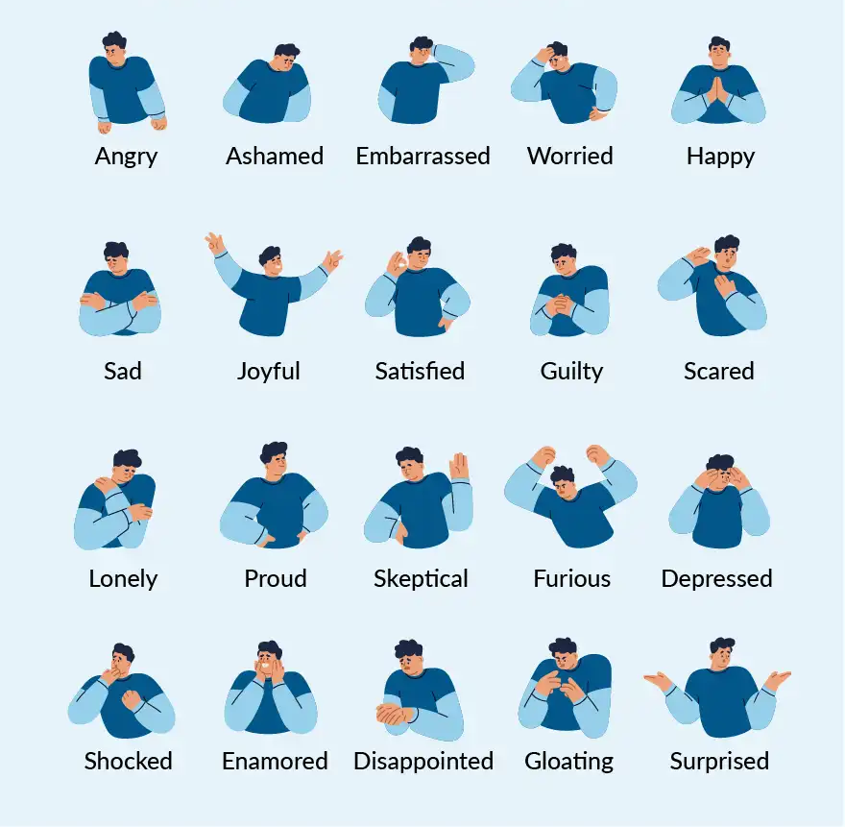
“The emotions you express—often without realizing it and without saying a word!”

Slide 8
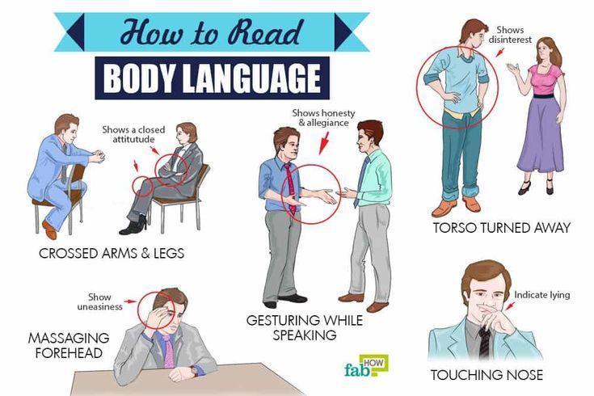

Slide 9

Watch & Learn –
‘Body Language’

Slide 10
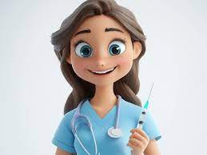
Facial Expressions
The First Language Patients Read
1

Slide 11
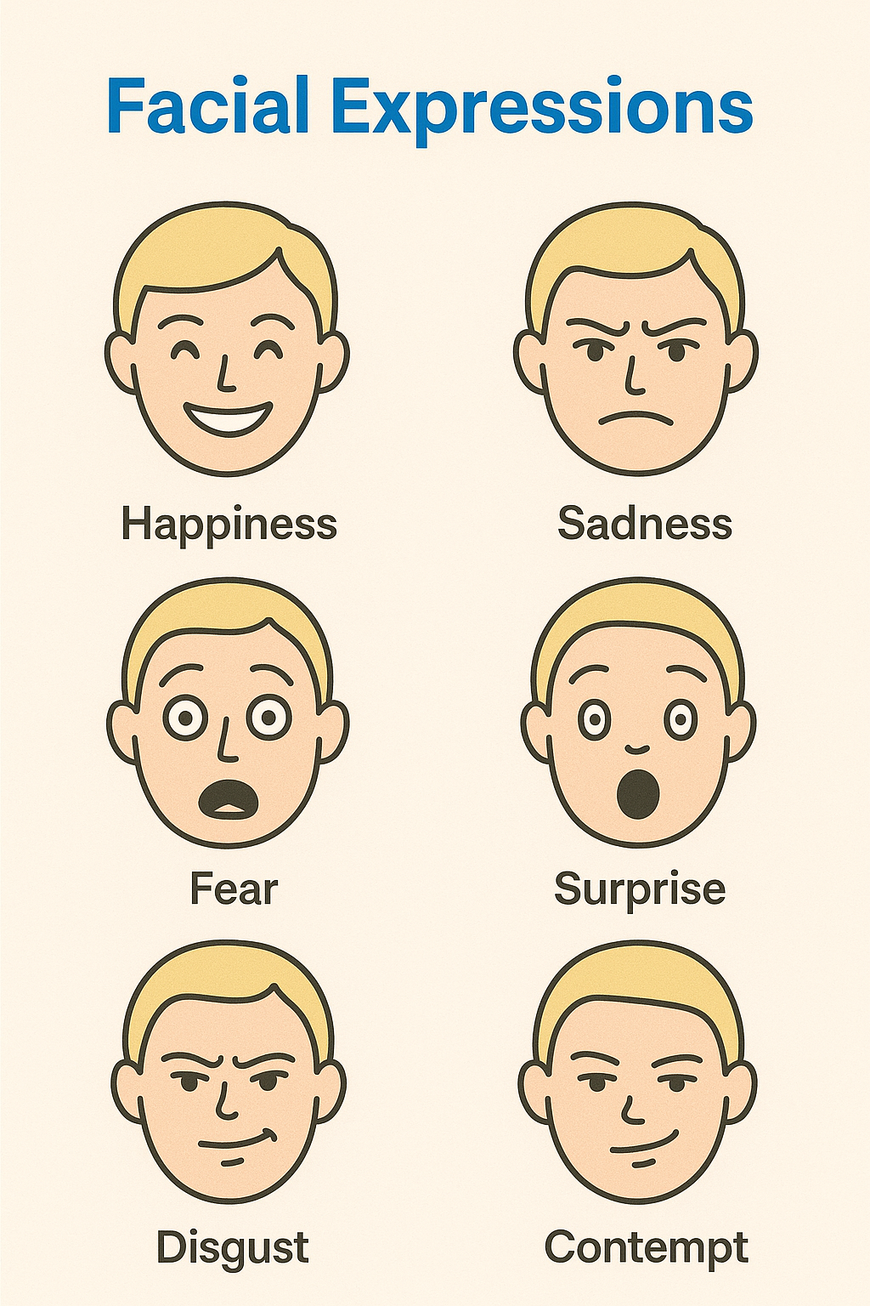
Types of Facial Expressions
These are the basic universal expressions that convey emotion:
Happiness (smile, relaxed eyes)
Sadness (downturned mouth, drooping eyelids)
Anger (furrowed brows, tight lips)
Fear (wide eyes, raised eyebrows)
Surprise (raised eyebrows, open mouth)
Disgust (wrinkled nose, raised upper lip)
Contempt (smirk or lip curl)
A nurse is expected to be emotionally intelligent by managing his/her feelings and not showing them on the face when it's not appropriate.

Slide 12

Fun facts about a smile
Smiling is contagious
Seeing someone smile activates the brain’s mirror neurons, making it more likely for others to smile in return. This helps build instant rapport and positive social connections.
Smiling boosts immunity
Positive emotions, often triggered by smiling,
have been linked to stronger immune function
and better physical health outcomes.
Smiles release “happy” chemicals
Smiling triggers the release of dopamine,
endorphins, and serotonin—natural mood
boosters that reduce stress and lower
blood pressure.
Smiling can make you look younger and more
competent
You can simply impress your audience and add a unique zing and appeal to your presence.
You can "fake it till you make it"
Women smile more than men
Even forced smiling can improve your mood. Studies show that the act of smiling—whether spontaneous or not—can positively affect your emotional state.
On an average, women smile more frequently
than men, especially in social contexts.
This may be partly cultural, but also linked to emotional expressiveness..

Slide 13
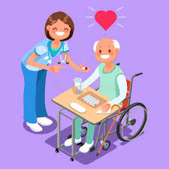



Why Facial Expressions Matter in Nursing?
Our face often speaks before we do—especially in healthcare.
Patients observe facial cues closely to interpret our intentions and emotional state.
Even without words, your expression can convey empathy, stress, confidence, or concern.
In high-stress environments like hospitals, nonverbal cues help patients feel secure or alarmed—depending on how they’re read.

Slide 14

Expression During Clinical Tasks
Maintain a calm, neutral expression while performing procedures (e.g., injections, dressing wounds).
This helps ease patient anxiety and communicates professionalism.
Avoid showing signs of haste or stress, which can transfer tension to the patient.
Remember!
Calm facial demeanor = assurance + competence.

Slide 15

The Power of a Smile
Warmth Through a Smile
A gentle, genuine smile can make patients feel welcome and understood.
It builds trust and sets a positive tone, especially during the first interaction.
Smiling when appropriate improves nurse-patient rapport.

Slide 16



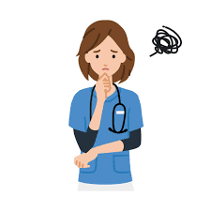

Watch Out for Negative Clues
What to Avoid?
Avoid frowning, eye-rolling, or tightening your jaw—these may be perceived as irritation or disapproval.
Patients are often vulnerable; even subtle expressions can be misinterpreted.
Discrepancy between facial expression and voice tone (e.g., a flat face with a kind voice) can confuse patients.
Aim for alignment between what you say and how you look.

Slide 17

Expressions in Emotionally Charged Situations
Show Compassion Visibly
In sensitive moments—like breaking bad news—your facial empathy matters deeply.
Maintain soft eye contact, a serious yet kind expression, and avoid abrupt changes in tone or face.
Let your expression mirror the emotion needed: concern, reassurance, or support.
Patients remember how they felt in these moments—
your face will say it all.

Slide 18

Facial Expressions
1.Which of the following is a universal facial expression recognized across cultures? A. Confusion B. Gratitude C. Disgust D. Interest
2. A nurse smiling gently during patient interaction most likely conveys: A. Indifference B. Reassurance C. Superiority D. Hesitation
3. What is the best expression to maintain during clinical procedures like injections? A. A cheerful and chatty face B. A serious, tense face C. A calm, neutral expression D. A smiling, excited face
4. What facial behavior can confuse patients if mismatched with tone of voice? A. A warm smile with an assertive tone B. A flat face with a kind voice C. A raised brow with direct instruction D. A gentle gaze with firm words
Patients are most likely to remember a nurse's: A. Clinical skill B. Uniform color C. Facial expression in emotional moments D. Medical terminology used
QUIZ

Slide 19


Eye Contact
Building Trust without Intimidation
2

Slide 20
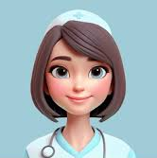
Interesting Facts about eye contact
1
2
3
4
5
6
Eye contact builds trust"
Too much or too little can backfire
Humans are wired to follow gaze
Cultural differences matter
It improves listening and understanding
In healthcare, it signals
compassion
Direct eye contact
creates a sense of
honesty and connection, which is essential
in nurse–
patient relationships.
While eye contact shows attentiveness, too much can feel intimidating, and too little may appear
disengaged or dishonest.
Eye contact can subtly
guide attention. When
someone looks at
something, others
instinctively
follow their gaze—
useful in patient
instruction.
In some cultures, strong eye contact shows
confidence and respect, while in others, it may
be seen as rude or
confrontational.
People tend to listen
more carefully and recall more when someone
maintains eye contact
during communication.
A nurse making calm
and kind eye contact
helps patients feel
heard, safe, and
respected.

Slide 21


Eye Contact in Nursing
Why Eye Contact Matters in Patient Care
Eye contact is a powerful nonverbal communication tool in healthcare
Eye contact Signals:
Your Complete Presence
Emotional Connection
Attentiveness
Appropriate eye contact helps build trust with patients and their families.
Nurses who use eye contact effectively are perceived as more caring and confident.

Slide 22



Maintain Natural Eye Contact
Attentiveness Without Intensity
Look at the patient while talking or listening to show genuine interest.
Use relaxed, natural eye contact to make patients feel heard.
Blink naturally and shift gaze occasionally to keep it comfortable.
Avoid staring—too much eye contact may feel aggressive or intrusive.

Slide 23
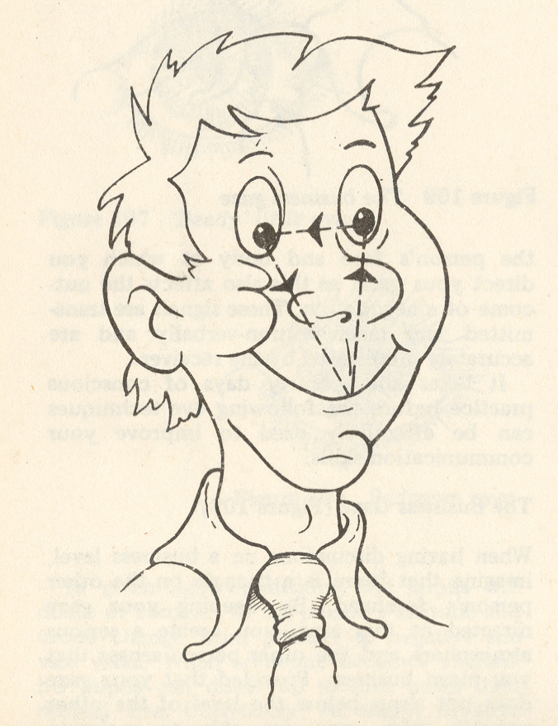
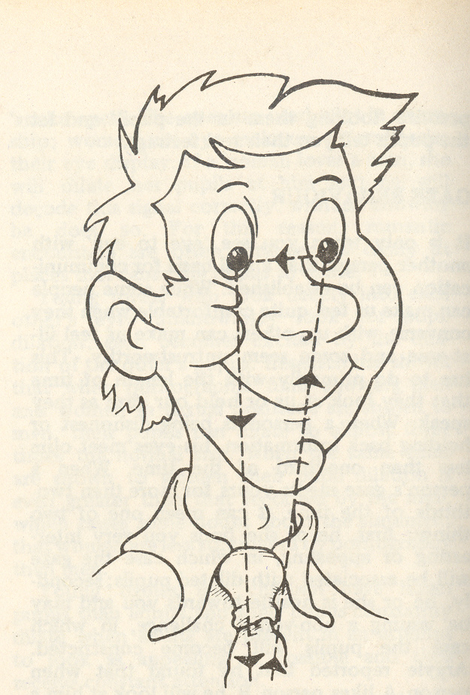
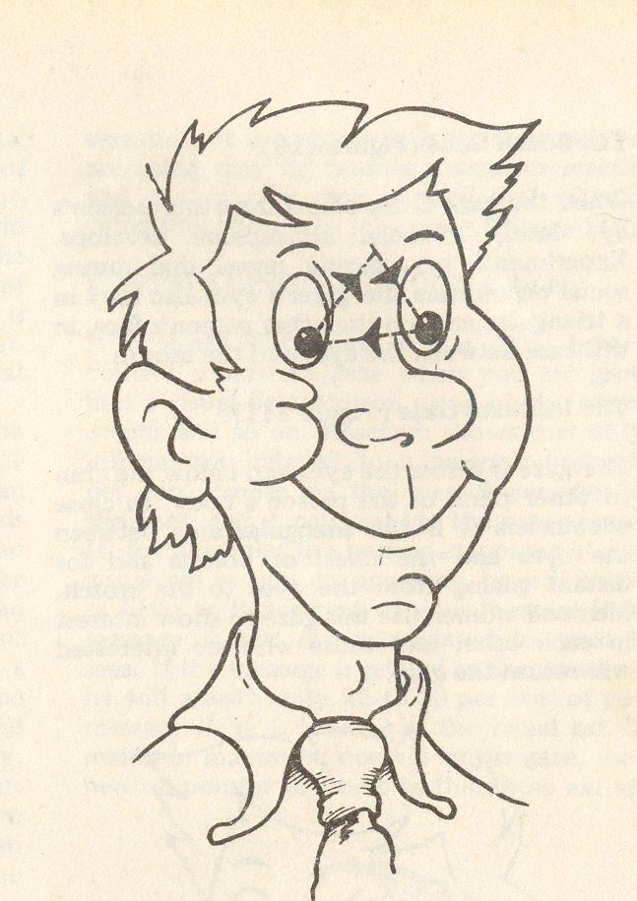
What should you remember while talking?
EYES
Business gaze
Social gaze
Intimate gaze
Maintain eye contact – the business gaze
Gaze directed in this triangle – serious atmosphere meaning business
Social gaze – drops below the other persons eye level – a social atmosphere created
Intimate gaze – across the eyes and below the chin

Slide 24

Interpretation - What Patients May Interpret from the Nurse’s Eye Behavior:
Side ways Glance
Prolonged, Unbroken Eye Contact
→ Patient may feel: “The nurse seems unsure or doesn’t trust me.” Interpretation: May come across as suspicious, doubtful, or lacking confidence in what’s being said or done.
→ Patient may feel: “This is intense… Am I being judged?” Interpretation: Can feel intimidating or invasive .
Staring Into Space or at the Chart While Patient Talks
Looking Down Frequently While Speaking
→ Patient may feel: “I don’t matter right now.” Interpretation: Comes across as disinterested, distracted, or inattentive, even if unintentional.
→ Patient may feel: “The nurse isn’t confident or is hiding something.” Interpretation: Might be seen as lack of confidence, embarrassment, or discomfort.
No eye contact
Rapid Blinking or Darting Eyes
→ Patient may feel: “The nurse isn’t interested in me or what I’m saying.” Interpretation: May appear disengaged, dismissive, or emotionally unavailable.
→ Patient may feel: “Is the nurse nervous or hiding something from me?” Interpretation: Signals stress, nervousness, or possible dishonesty.

Slide 25
Too much eye contact can make a patient feel: A. Ignored B. Respected C. Intimidated D. Uninformed
Natural eye contact helps patients feel: A. Controlled B. Rushed C. Heard D. Overlooked
In some cultures, direct eye contact may be perceived as: A. Trustworthy B. Disrespectful C. Encouraging D. Passive
A nurse using appropriate eye contact is likely seen as: A. Arrogant B. Unprepared C. Caring D. Detached
Which type of gaze is best used in professional nurse–patient interaction? A. Intimate gaze B. Social gaze C. Avoidant gaze D. Business gaze
QUIZ
Eye Contact

Slide 26

Posture
Posture – Your Silent Signal of Confidence and Readiness
3

Slide 27
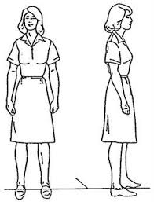
What Posture Communicates
Posture Speaks Before You Do
Posture is a key element of body language that silently signals your mindset, confidence, and approachability.
In clinical settings, patients and colleagues quickly assess your readiness and professionalism through your body stance.
Good posture enhances not just how others see you—but also how you feel and perform.

Slide 28


The Power of Upright Posture
Alert, Confident, and Professional
02
01
Avoid crossing your arms or
creating barriers; it may
seem like you're closed off
or disapproving
Lean slightly forward when listening
to patients or colleagues—it shows
genuine interest.
04
03
Combine posture with appropriate nodding and eye contact for full engagement.
Open posture invites open conversation—especially important during emotional or sensitive interactions.

Slide 29

The Power of Upright Posture
Stand or sit with your back straight, shoulders relaxed, and chin slightly up.
Upright posture conveys energy, alert, confident, professional,attentiveness, and readiness to assist.
Slouching or leaning backward can imply fatigue, disinterest, or lack of confidence.
Your posture can affect how much trust and respect patients feel toward you.

Slide 30

Listening with Your Body
Engaged and Compassionate Presence
Lean slightly forward when listening to patients or colleagues—it shows genuine interest.
Maintain physical stability when standing or sitting—avoid unnecessary swaying, tapping, or fidgeting.
Open posture invites open conversation—especially important during emotional or sensitive interactions.
Combine posture with appropriate nodding and eye contact for full engagement.

